Slide 1
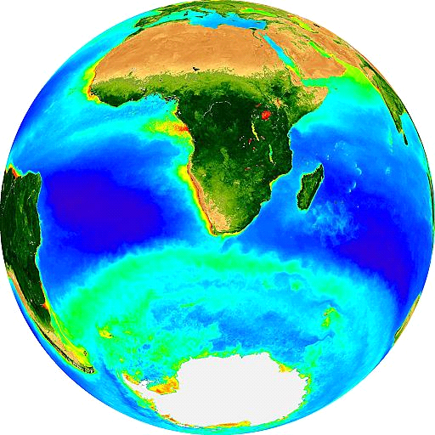
Marine Carbon Cycle III
Dr. Sarah Fawcett
sarah.fawcett@uct.ac.za
29 May 2017

Slide 2
Studying the marine carbon cycle
Goal: to understand how the ocean controls the atmospheric concentration of CO₂
The ocean acts as a buffer to dissolving CO₂
How?
(1) Carbonate equilibrium

Slide 3
Studying the marine carbon cycle
Goal: to understand how the ocean controls the atmospheric concentration of CO₂
The ocean acts as a buffer to dissolving CO₂
How?
Carbonate equilibrium: CO₂ is highly soluble in seawater
Seawater alkalinity

Slide 4
(1) CO₂ is highly soluble in seawater
Concentration of CO₂ in seawater is low
CO₂ + H₂O ↔ H₂CO₃ ↔ HCO₃⁻ + H⁺ ↔ CO₃²⁻ + H⁺
Conversion to ionic forms decreases oceanic CO₂ and more atmospheric CO₂ can be dissolved
For every 20 molecules of CO₂ absorbed by the ocean,
19 are rapidly converted to HCO₃⁻ and CO₃²⁻
Carbonate equilibrium: reactions provide a chemical buffer, maintain ocean pH within a narrow range, and constrain the amount of atmospheric CO₂ the ocean can absorb
DIC = CO₂ + HCO₃⁻ + CO₃²⁻
Dissolved inorganic carbon = CO₂ + bicarbonate + carbonate

Slide 5
Studying the marine carbon cycle
Goal: to understand how the ocean controls the atmospheric concentration of CO₂
The ocean acts as a buffer to dissolving CO₂
How?
Carbonate equilibrium: CO₂ is highly soluble in seawater
Seawater alkalinity

Slide 6
(2) Alkalinity
“I found at least 20 different definitions of alkalinity”
An ocean carbon cycle modeller from Hamburg
“… alkalinity, one of the most central, but perhaps not the best understood concept in aquatic chemistry.”
Morel and Hering, 1993
While DIC keeps track of the carbon, alkalinity keeps track of the charges

Slide 7
Seawater alkalinity: definitions
A measure of excess bases over acids
Alk = [HCO₃⁻] + 2[CO₃²⁻] + [OH⁻] – [H⁺] + [B(OH)₄⁻] + minor bases
CA = [HCO₃⁻] + 2[CO₃²⁻] (carbonate alkalinity) (Eqn 6)
The charge balance of all major cations and anions
Alk = [Na⁺] + [K⁺] + 2[Mg²⁺] + 2[Ca²⁺] + minor cations – [Cl⁻] – 2[SO₄²⁻] – [Br⁻] – [NO₃⁻] – minor anions

Slide 8
Seawater alkalinity
Major input of alkalinity to the ocean: weathering of carbonate and silicate rocks on land
Major loss/output of ocean alkalinity: burial of CaCO₃ on the seafloor
Inputs and outputs of ocean alkalinity are balanced
If not for the biological precipitation of CaCO₃, ocean pH would have to be higher to spontaneously precipitate CaCO₃ to balance the alkalinity input.

Slide 9
Seawater alkalinity: definitions
A measure of excess bases over acids
Alk = [HCO₃⁻] + 2[CO₃²⁻] + [OH⁻] – [H⁺] + [B(OH)₄⁻] + minor bases
CA = [HCO₃⁻] + 2[CO₃²⁻] (carbonate alkalinity) (Eqn 6)
The charge balance of all major cations and anions
Alk = [Na⁺] + [K⁺] + 2[Mg²⁺] + 2[Ca²⁺] + minor cations – [Cl⁻] – 2[SO₄²⁻] – [Br⁻] – [NO₃⁻] – minor anions

Slide 10
Seawater alkalinity
Major input of alkalinity to the ocean: weathering of carbonate and silicate rocks on land
Major loss/output of ocean alkalinity: burial of CaCO₃ on the seafloor
Inputs and outputs of ocean alkalinity are balanced
If not for the biological precipitation of CaCO₃, ocean pH would have to be higher to spontaneously precipitate CaCO₃ to balance the alkalinity input.

Slide 11
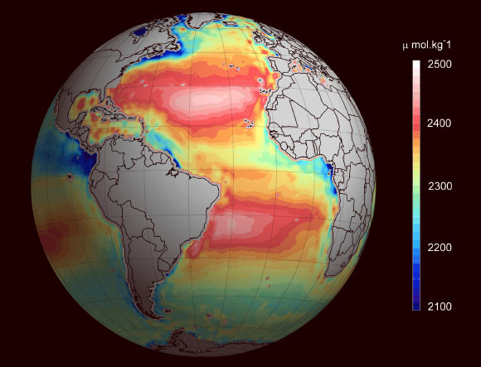
Surface seawater alkalinity

Slide 12
Surface seawater alkalinity
Very strong relationship between alkalinity and salinity, with higher salinity → higher alkalinity
Alk = [Na⁺] + [K⁺] + 2[Mg²⁺] + 2[Ca²⁺] + … – [Cl⁻] – 2[SO₄²⁻] – [Br⁻] – [NO₃⁻] – …
Other sources of surface alkalinity: upwelling of high [Ca²⁺] and [CO₃²⁻] waters

Slide 13
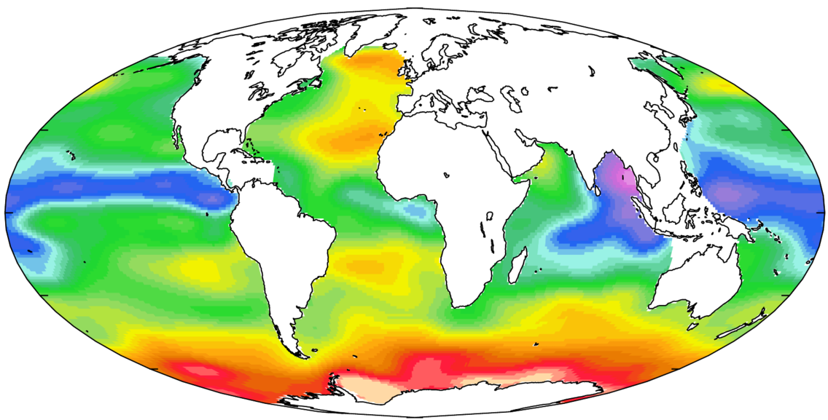
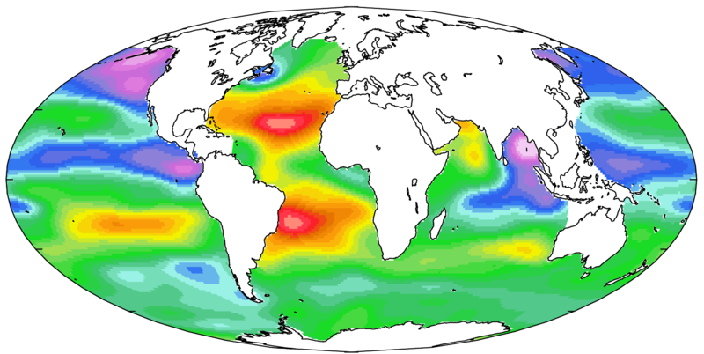
DIC
Alkalinity

Slide 14
Biogeochemical processes affecting
DIC and Alk
Process | Total DIC | Total Alk
Air-sea CO₂ exchange
Photosynthesis
Respiration
CaCO₃ dissolution
CaCO₃ precipitation

Slide 15
Biogeochemical processes affecting
DIC and Alk
DIC = CO₂ + HCO₃⁻ + CO₃²⁻
Alk = [HCO₃⁻] + 2[CO₃²⁻] + [OH⁻] – [H⁺] + [B(OH)₄⁻]
= [Na⁺] + [K⁺] + 2[Mg²⁺] + 2[Ca²⁺] – [Cl⁻] – 2[SO₄²⁻] – [Br⁻] – [NO₃⁻] + minor cations – minor anions
Air-sea flux: CO₂(g) ←→ CO₂ (1)
CO₂ + H₂O ←→ HCO₃⁻ + H⁺ (2)
CO₃²⁻ + H⁺ ←→ HCO₃⁻ (3)
CO₂ + CO₃²⁻ + H₂O ←→ 2HCO₃⁻
DIC increases but Alk does not change
DIC = CO₂ + HCO₃⁻ + CO₃²⁻
Alk = [HCO₃⁻] + 2[CO₃²⁻] + [OH⁻] – [H⁺] + [B(OH)₄⁻]
= [Na⁺] + [K⁺] + 2[Mg²⁺] + 2[Ca²⁺] – [Cl⁻] – 2[SO₄²⁻] – [Br⁻]
– [NO₃⁻] – 3[PO₄³⁻] + minor cations – minor anions
DIC = CO₂ + HCO₃⁻ + CO₃²⁻
Alk = [HCO₃⁻] + 2[CO₃²⁻] + [OH⁻] – [H⁺] + [B(OH)₄⁻]
= [Na⁺] + [K⁺] + 2[Mg²⁺] + 2[Ca²⁺] – [Cl⁻] – 2[SO₄²⁻] – [Br⁻] – [NO₃⁻] + minor cations – minor anions
Air-sea flux: CO₂(g) ←→ CO₂ (1)
CO₂ + H₂O ←→ HCO₃⁻ + H⁺ (2)
CO₃²⁻ + H⁺ ←→ HCO₃⁻ (3)
CO₂ + CO₃²⁻ + H₂O ←→ 2HCO₃⁻
DIC increases but Alk does not change

Slide 16
Biogeochemical processes affecting
DIC and Alk
DIC = CO₂ + HCO₃⁻ + CO₃²⁻
Alk = [HCO₃⁻] + 2[CO₃²⁻] + [OH⁻] – [H⁺] + [B(OH)₄⁻]
= [Na⁺] + [K⁺] + 2[Mg²⁺] + 2[Ca²⁺] – [Cl⁻] – 2[SO₄²⁻] – [Br⁻] – [NO₃⁻] + minor cations – minor anions
Air-sea flux: CO₂(g) ←→ CO₂ (1)
CO₂ + H₂O ←→ HCO₃⁻ + H⁺ (2)
CO₃²⁻ + H⁺ ←→ HCO₃⁻ (3)
CO₂ + CO₃²⁻ + H₂O ←→ 2HCO₃⁻
DIC changes but Alk does not change
DIC = CO₂ + HCO₃⁻ + CO₃²⁻
Alk = [HCO₃⁻] + 2[CO₃²⁻] + [OH⁻] – [H⁺] + [B(OH)₄⁻]
= [Na⁺] + [K⁺] + 2[Mg²⁺] + 2[Ca²⁺] – [Cl⁻] – 2[SO₄²⁻] – [Br⁻]
– [NO₃⁻] – 3[PO₄³⁻] + minor cations – minor anions

Slide 17
Biogeochemical processes affecting
DIC and Alk
DIC = CO₂ + HCO₃⁻ + CO₃²⁻
Alk = [HCO₃⁻] + 2[CO₃²⁻] + [OH⁻] – [H⁺] + [B(OH)₄⁻]
= [Na⁺] + [K⁺] + 2[Mg²⁺] + 2[Ca²⁺] – [Cl⁻] – 2[SO₄²⁻] – [Br⁻] – [NO₃⁻] + minor cations – minor anions
Air-sea flux: CO₂(g) ←→ CO₂
CO₂ + H₂O ←→ HCO₃⁻ + H⁺
HCO₃⁻ ←→ CO₃²⁻ + H⁺
CO₂(g) + H₂O ←→ CO₃²⁻ + 2H⁺
DIC changesand Alk does not change
DIC = CO₂ + HCO₃⁻ + CO₃²⁻
Alk = [HCO₃⁻] + 2[CO₃²⁻] + [OH⁻] – [H⁺] + [B(OH)₄⁻]
= [Na⁺] + [K⁺] + 2[Mg²⁺] + 2[Ca²⁺] – [Cl⁻] – 2[SO₄²⁻] – [Br⁻]
– [NO₃⁻] – 3[PO₄³⁻] + minor cations – minor anions

Slide 18
Biogeochemical processes affecting
DIC and Alk
DIC = CO₂ + HCO₃⁻ + CO₃²⁻
Alk = [HCO₃⁻] + 2[CO₃²⁻] + [OH⁻] – [H⁺] + [B(OH)₄⁻]
= [Na⁺] + [K⁺] + 2[Mg²⁺] + 2[Ca²⁺] – [Cl⁻] – 2[SO₄²⁻] – [Br⁻] – [NO₃⁻] + minor cations – minor anions
Air-sea flux: CO₂(g) ←→ CO₂
CO₂ + H₂O ←→ HCO₃⁻ + H⁺
HCO₃⁻ ←→ CO₃²⁻ + H⁺
CO₂(g) + H₂O ←→ CO₃²⁻ + 2H⁺
DIC changesand Alk does not change
DIC = CO₂ + HCO₃⁻ + CO₃²⁻
Alk = [HCO₃⁻] + 2[CO₃²⁻] + [OH⁻] – [H⁺] + [B(OH)₄⁻]
= [Na⁺] + [K⁺] + 2[Mg²⁺] + 2[Ca²⁺] – [Cl⁻] – 2[SO₄²⁻] – [Br⁻]
– [NO₃⁻] – 3[PO₄³⁻] + minor cations – minor anions
charges are balanced

Slide 19
Biogeochemical processes affecting
DIC and Alk
DIC = CO₂ + HCO₃⁻ + CO₃²⁻
Alk = [HCO₃⁻] + 2[CO₃²⁻] + [OH⁻] – [H⁺] + [B(OH)₄⁻]
= [Na⁺] + [K⁺] + 2[Mg²⁺] + 2[Ca²⁺] – [Cl⁻] – 2[SO₄²⁻] – [Br⁻] – [NO₃⁻] + minor cations – minor anions
Air-sea flux: CO₂(g) ←→ CO₂
CO₂ + H₂O ←→ HCO₃⁻ + H⁺
HCO₃⁻ ←→ CO₃²⁻ + H⁺
CO₂(g) + H₂O ←→ CO₃²⁻ + 2H⁺
DIC changes but Alk does not change
DIC = CO₂ + HCO₃⁻ + CO₃²⁻
Alk = [HCO₃⁻] + 2[CO₃²⁻] + [OH⁻] – [H⁺] + [B(OH)₄⁻]
= [Na⁺] + [K⁺] + 2[Mg²⁺] + 2[Ca²⁺] – [Cl⁻] – 2[SO₄²⁻] – [Br⁻]
– [NO₃⁻] – 3[PO₄³⁻] + minor cations – minor anions

Slide 20
Biogeochemical processes affecting
DIC and Alk
DIC = CO₂ + HCO₃⁻ + CO₃²⁻
Alk = [HCO₃⁻] + 2[CO₃²⁻] + [OH⁻] – [H⁺] + [B(OH)₄⁻]
= [Na⁺] + [K⁺] + 2[Mg²⁺] + 2[Ca²⁺] – [Cl⁻] – 2[SO₄²⁻] – [Br⁻]
– [NO₃⁻] – 3[PO₄³⁻] + minor cations – minor anions
Photosynthesis/respiration:
106 CO₂ + 16 HNO₃ + H₃PO₄ ←→ C₁₀₆H₁₇₅O₄₂N₁₆P + 150 O₂
Photosynthesis: DIC decreases and Alk increases slightly
Respiration: DIC increases and Alk decreases slightly
DIC = CO₂ + HCO₃⁻ + CO₃²⁻
Alk = [HCO₃⁻] + 2[CO₃²⁻] + [OH⁻] – [H⁺] + [B(OH)₄⁻]
= [Na⁺] + [K⁺] + 2[Mg²⁺] + 2[Ca²⁺] – [Cl⁻] – 2[SO₄²⁻] – [Br⁻]
– [NO₃⁻] – 3[PO₄³⁻] + minor cations – minor anions

Slide 21
Biogeochemical processes affecting
DIC and Alk
DIC = CO₂ + HCO₃⁻ + CO₃²⁻
Alk = [HCO₃⁻] + 2[CO₃²⁻] + [OH⁻] – [H⁺] + [B(OH)₄⁻]
= [Na⁺] + [K⁺] + 2[Mg²⁺] + 2[Ca²⁺] – [Cl⁻] – 2[SO₄²⁻] – [Br⁻]
– [NO₃⁻] – 3[PO₄³⁻] + minor cations – minor anions
Photosynthesis/respiration:
106 CO₂ + 16 HNO₃ + H₃PO₄ ←→ C₁₀₆H₁₇₅O₄₂N₁₆P + 150 O₂
Photosynthesis: DIC decreases and Alk increases slightly
Respiration: DIC increases and Alk decreases slightly
DIC = CO₂ + HCO₃⁻ + CO₃²⁻
Alk = [HCO₃⁻] + 2[CO₃²⁻] + [OH⁻] – [H⁺] + [B(OH)₄⁻]
= [Na⁺] + [K⁺] + 2[Mg²⁺] + 2[Ca²⁺] – [Cl⁻] – 2[SO₄²⁻] – [Br⁻]
– [NO₃⁻] – 3[PO₄³⁻] + minor cations – minor anions

Slide 22
Biogeochemical processes affecting
DIC and Alk
DIC = CO₂ + HCO₃⁻ + CO₃²⁻
Alk = [HCO₃⁻] + 2[CO₃²⁻] + [OH⁻] – [H⁺] + [B(OH)₄⁻]
= [Na⁺] + [K⁺] + 2[Mg²⁺] + 2[Ca²⁺] – [Cl⁻] – 2[SO₄²⁻] – [Br⁻]
– [NO₃⁻] – 3[PO₄³⁻] + minor cations – minor anions
Photosynthesis/respiration:
106 CO₂ + 16 HNO₃ + H₃PO₄ ←→ C₁₀₆H₁₇₅O₄₂N₁₆P + 150 O₂
Photosynthesis: DIC decreases and Alk increases slightly
Respiration: DIC increases and Alk decreases slightly
DIC = CO₂ + HCO₃⁻ + CO₃²⁻
Alk = [HCO₃⁻] + 2[CO₃²⁻] + [OH⁻] – [H⁺] + [B(OH)₄⁻]
= [Na⁺] + [K⁺] + 2[Mg²⁺] + 2[Ca²⁺] – [Cl⁻] – 2[SO₄²⁻] – [Br⁻]
– [NO₃⁻] – 3[PO₄³⁻] + minor cations – minor anions

Slide 23
Biogeochemical processes affecting
DIC and Alk
DIC = CO₂ + HCO₃⁻ + CO₃²⁻
Alk = [HCO₃⁻] + 2[CO₃²⁻] + [OH⁻] – [H⁺] + [B(OH)₄⁻]
= [Na⁺] + [K⁺] + 2[Mg²⁺] + 2[Ca²⁺] – [Cl⁻] – 2[SO₄²⁻] – [Br⁻]
– [NO₃⁻] – 3[PO₄³⁻] + minor cations – minor anions
CaCO₃ dissolution/precipitation
Ca²⁺ + CO₃²⁻ ←→ CaCO₃
Dissolution: DIC increases and Alk increases (by 2x ΔDIC)
Precipitation: DIC decreases and Alk decreases (by 2x ΔDIC)
DIC = CO₂ + HCO₃⁻ + CO₃²⁻
Alk = [HCO₃⁻] + 2[CO₃²⁻] + [OH⁻] – [H⁺] + [B(OH)₄⁻]
= [Na⁺] + [K⁺] + 2[Mg²⁺] + 2[Ca²⁺] – [Cl⁻] – 2[SO₄²⁻] – [Br⁻]
– [NO₃⁻] – 3[PO₄³⁻] + minor cations – minor anions

Slide 24
Biogeochemical processes affecting
DIC and Alk
DIC = CO₂ + HCO₃⁻ + CO₃²⁻
Alk = [HCO₃⁻] + 2[CO₃²⁻] + [OH⁻] – [H⁺] + [B(OH)₄⁻]
= [Na⁺] + [K⁺] + 2[Mg²⁺] + 2[Ca²⁺] – [Cl⁻] – 2[SO₄²⁻] – [Br⁻]
– [NO₃⁻] – 3[PO₄³⁻] + minor cations – minor anions
CaCO₃ dissolution/precipitation
Ca²⁺ + CO₃²⁻ ←→ CaCO₃
Dissolution: DIC increases and Alk increases (by 2x ΔDIC)
Precipitation: DIC decreases and Alk decreases (by 2x ΔDIC)
DIC = CO₂ + HCO₃⁻ + CO₃²⁻
Alk = [HCO₃⁻] + 2[CO₃²⁻] + [OH⁻] – [H⁺] + [B(OH)₄⁻]
= [Na⁺] + [K⁺] + 2[Mg²⁺] + 2[Ca²⁺] – [Cl⁻] – 2[SO₄²⁻] – [Br⁻]
– [NO₃⁻] – 3[PO₄³⁻] + minor cations – minor anions

Slide 25
Biogeochemical processes affecting
DIC and Alk
DIC = CO₂ + HCO₃⁻ + CO₃²⁻
Alk = [HCO₃⁻] + 2[CO₃²⁻] + [OH⁻] – [H⁺] + [B(OH)₄⁻]
= [Na⁺] + [K⁺] + 2[Mg²⁺] + 2[Ca²⁺] – [Cl⁻] – 2[SO₄²⁻] – [Br⁻]
– [NO₃⁻] – 3[PO₄³⁻] + minor cations – minor anions
CaCO₃ dissolution/precipitation
Ca²⁺ + CO₃²⁻ ←→ CaCO₃
Dissolution: DIC increases and Alk increases (by 2x ΔDIC)
Precipitation: DIC decreases and Alk decreases (by 2x ΔDIC)
DIC = CO₂ + HCO₃⁻ + CO₃²⁻
Alk = [HCO₃⁻] + 2[CO₃²⁻] + [OH⁻] – [H⁺] + [B(OH)₄⁻]
= [Na⁺] + [K⁺] + 2[Mg²⁺] + 2[Ca²⁺] – [Cl⁻] – 2[SO₄²⁻] – [Br⁻]
– [NO₃⁻] – 3[PO₄³⁻] + minor cations – minor anions

Slide 26
Biogeochemical processes affecting
DIC and Alk
Process | Total DIC | Total Alk
Air-sea CO₂ exchange | Δ | -
Photosynthesis | ⬇ | ↑
Respiration | ⬆ | ↓
CaCO₃ dissolution | ⬆ | 2 x ⬆
CaCO₃ precipitation | ⬇ | 2 x ⬇

Slide 27
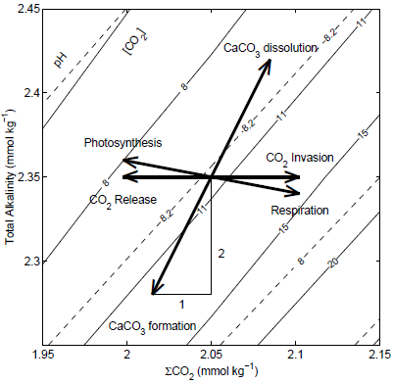
Summary: DIC and alkalinity
Total alkalinity (mmol/kg)
DIC (mmol/kg)
Zeebe and Wolf-Gladrow 2001

